Slide 1
Report Slides

Slide 2
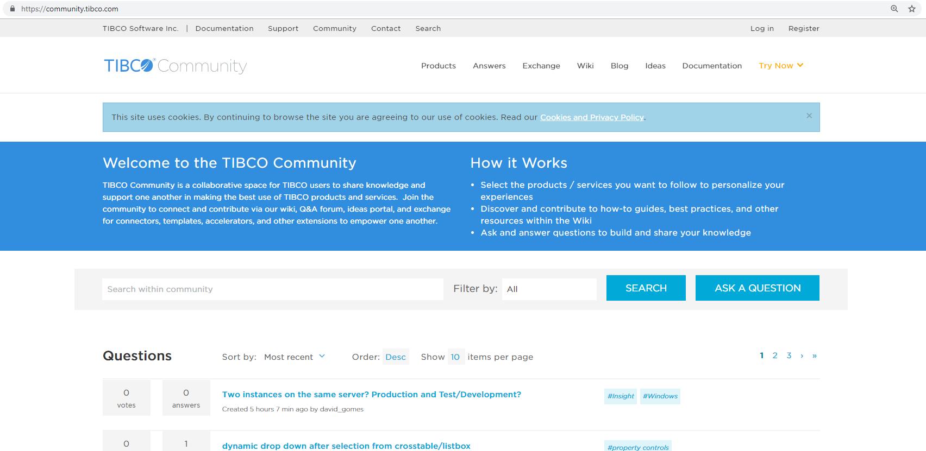
1
2
4
3

Slide 3





Slide 4







Slide 5
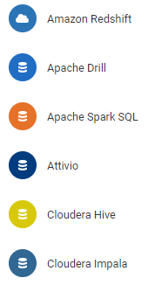
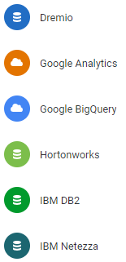
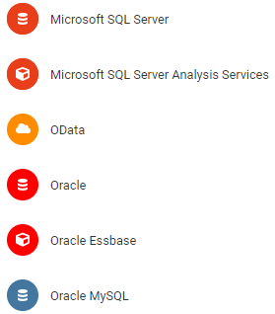
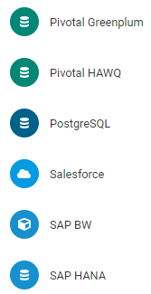
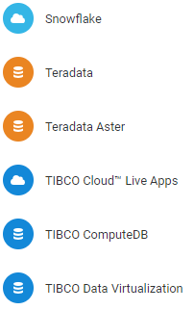
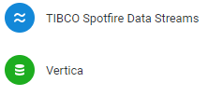
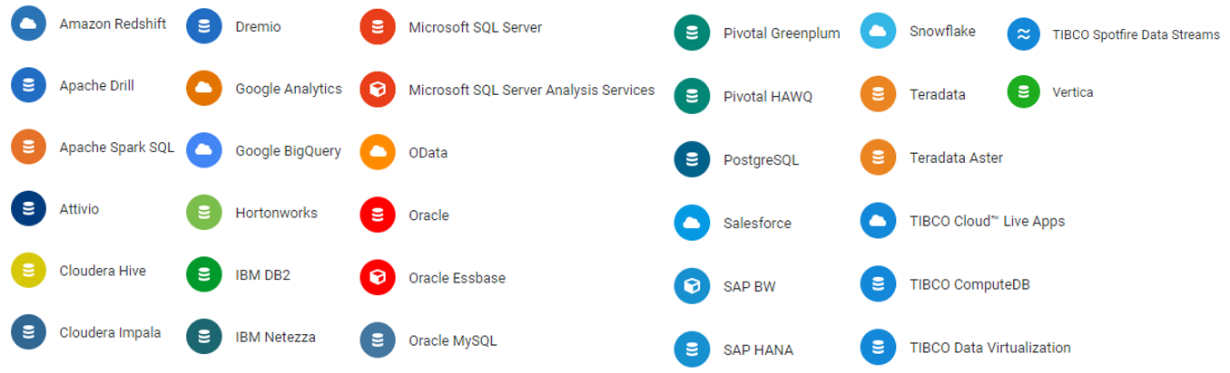

Slide 6
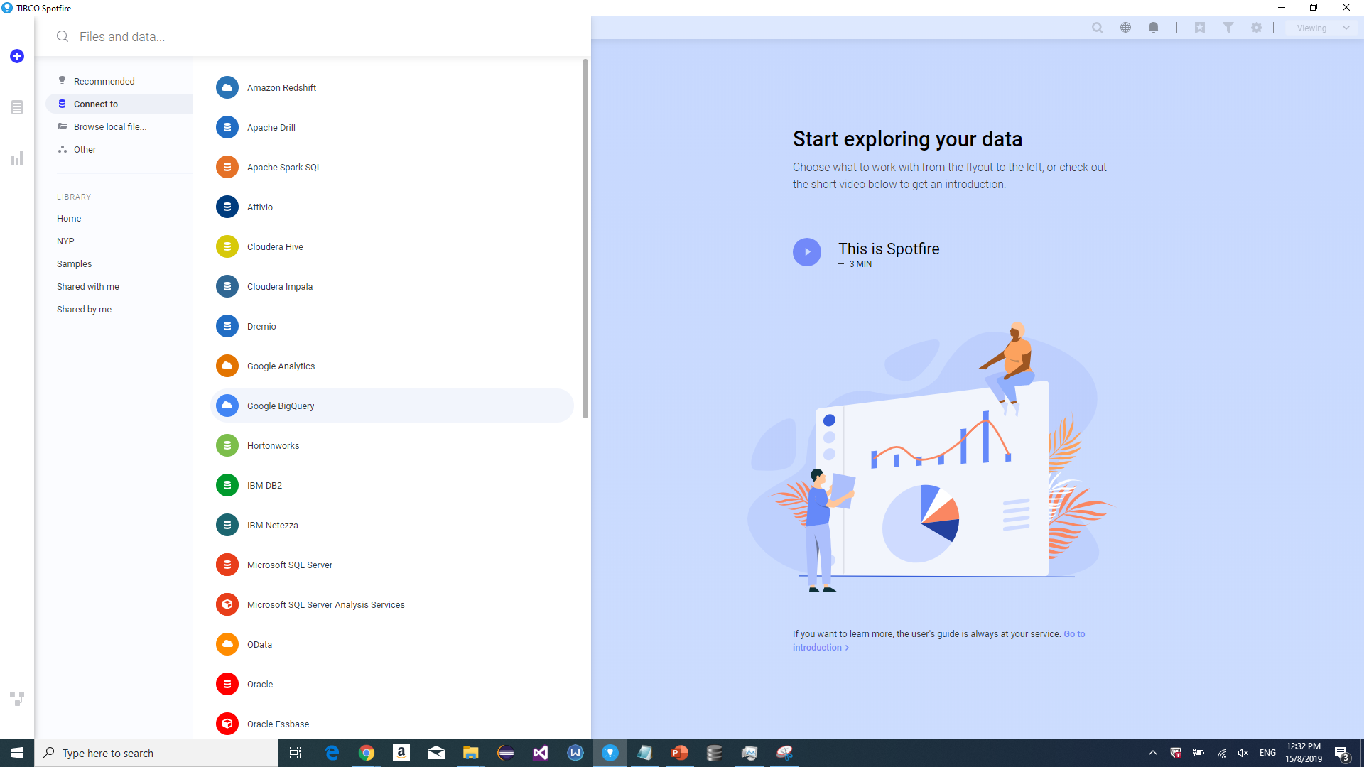

Slide 8
Usage Guide Spotfire TIBCO

Slide 9
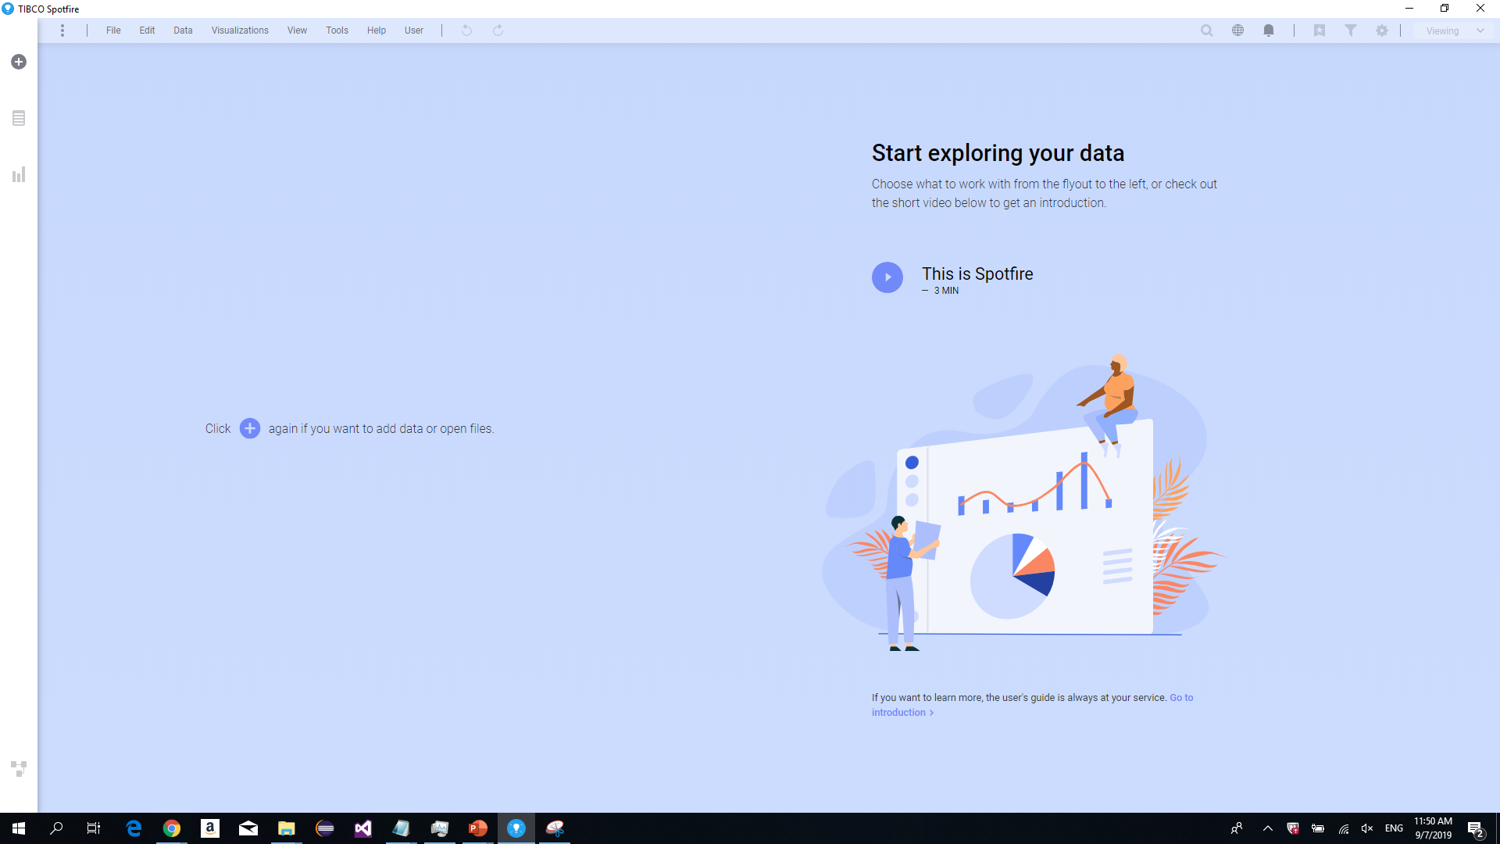

Slide 10
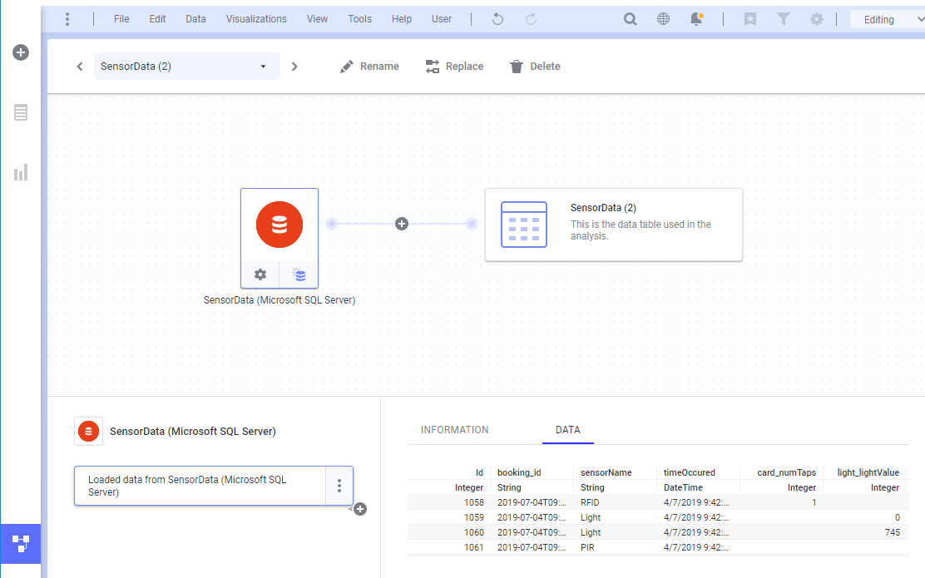
2
3
4
1

Slide 11
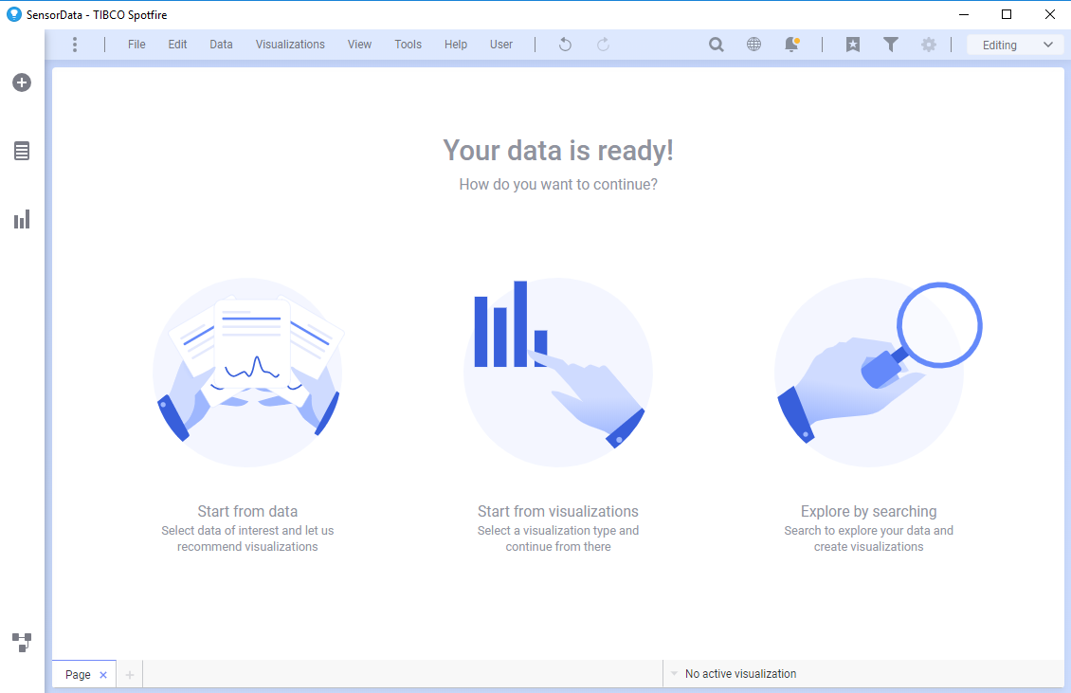
3
4
5
1
2
6

Slide 12
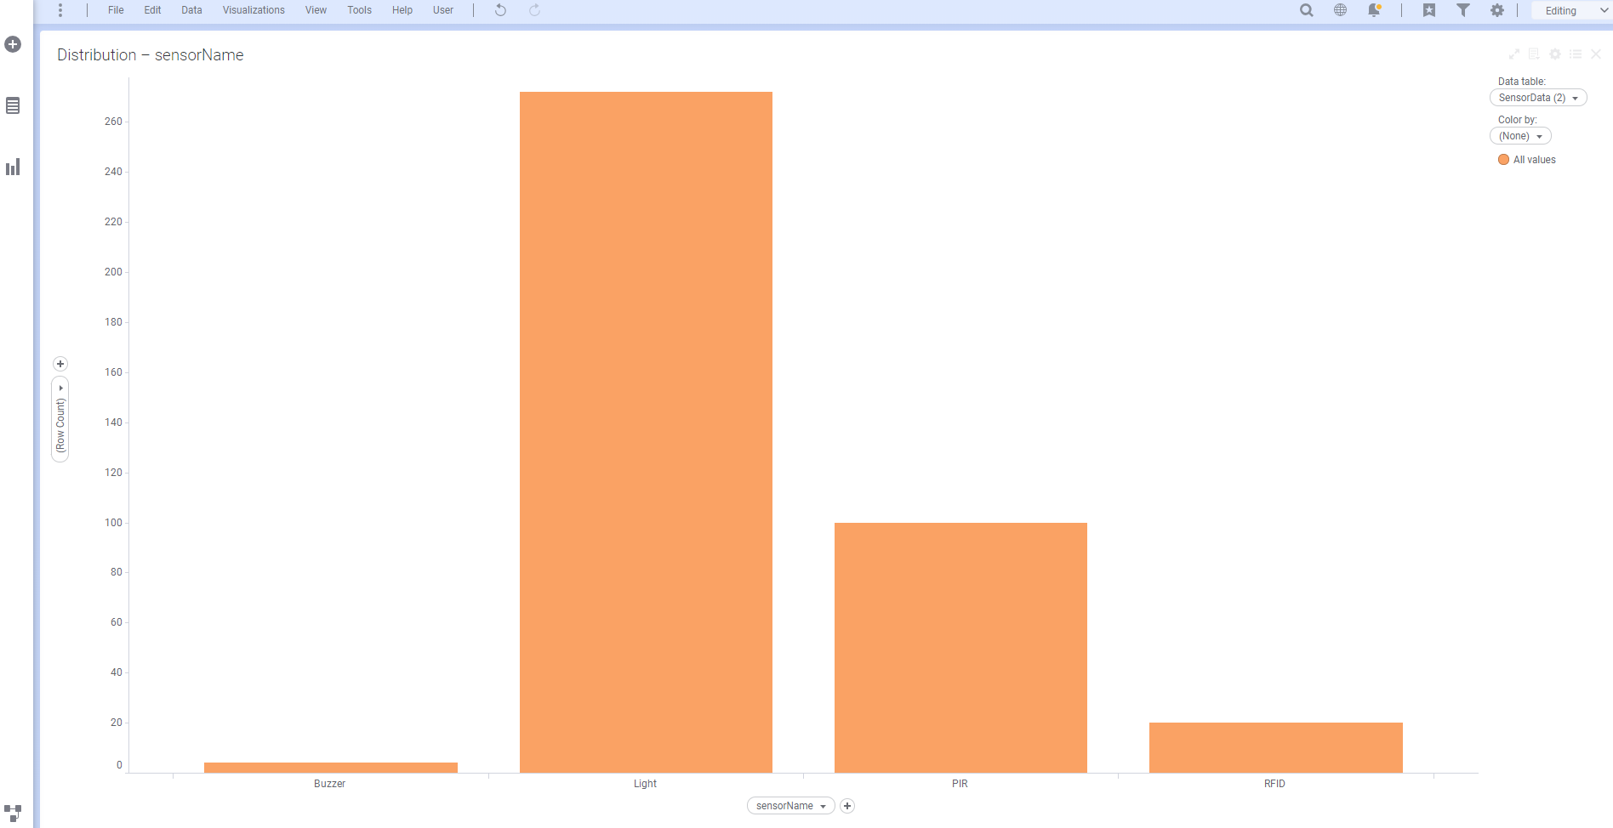
1
2
3
3

Slide 13
Usage Guide Google BigQuery

Slide 14
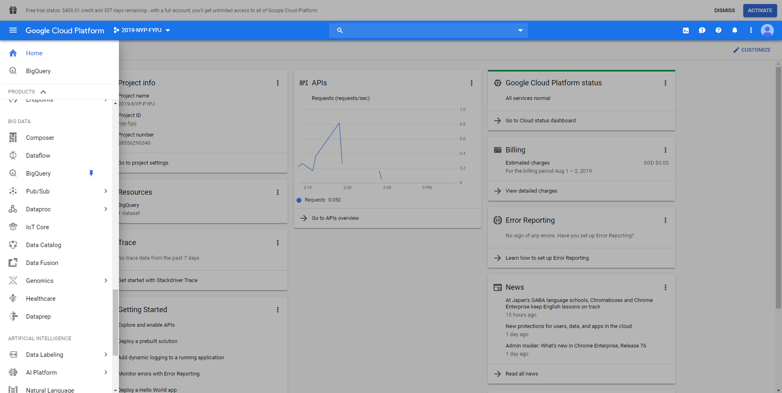
2
1
3

Slide 15
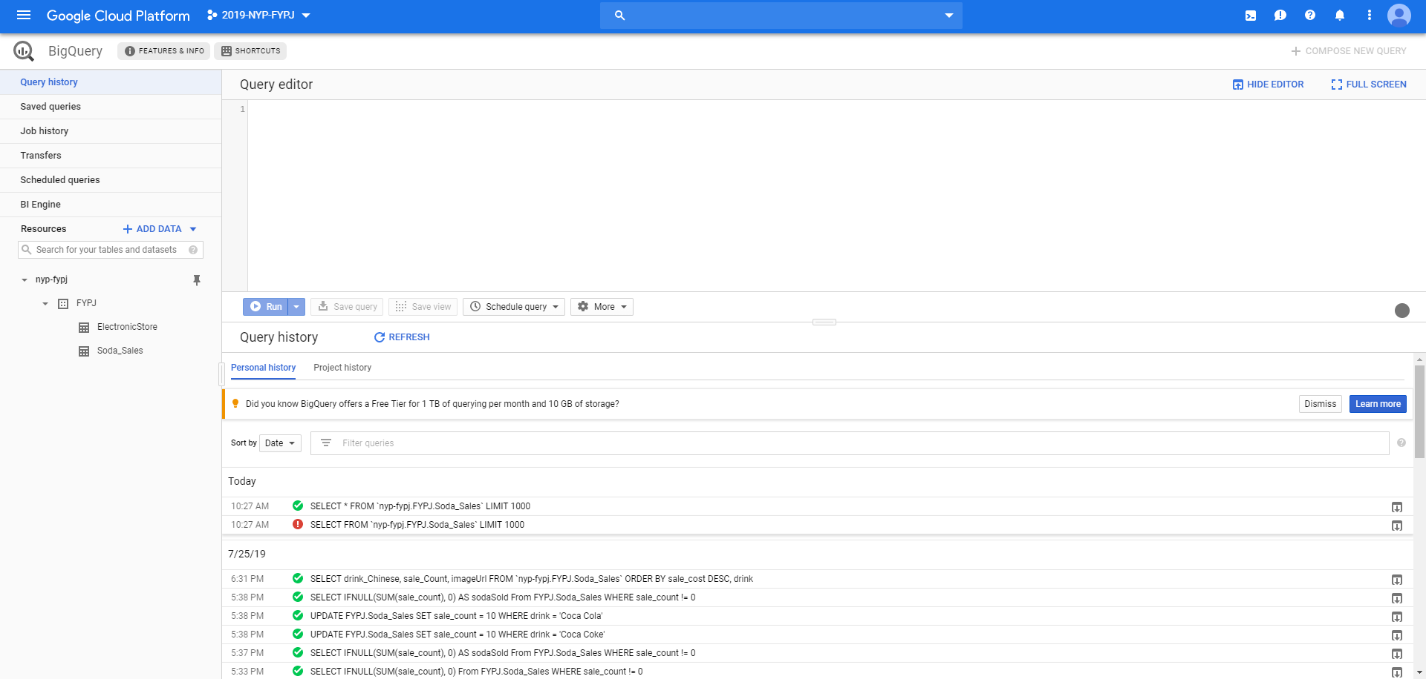

Slide 16
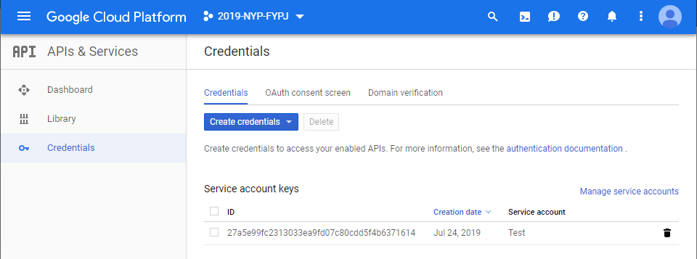

Slide 17
Usage Guide AWS RDS

Slide 18
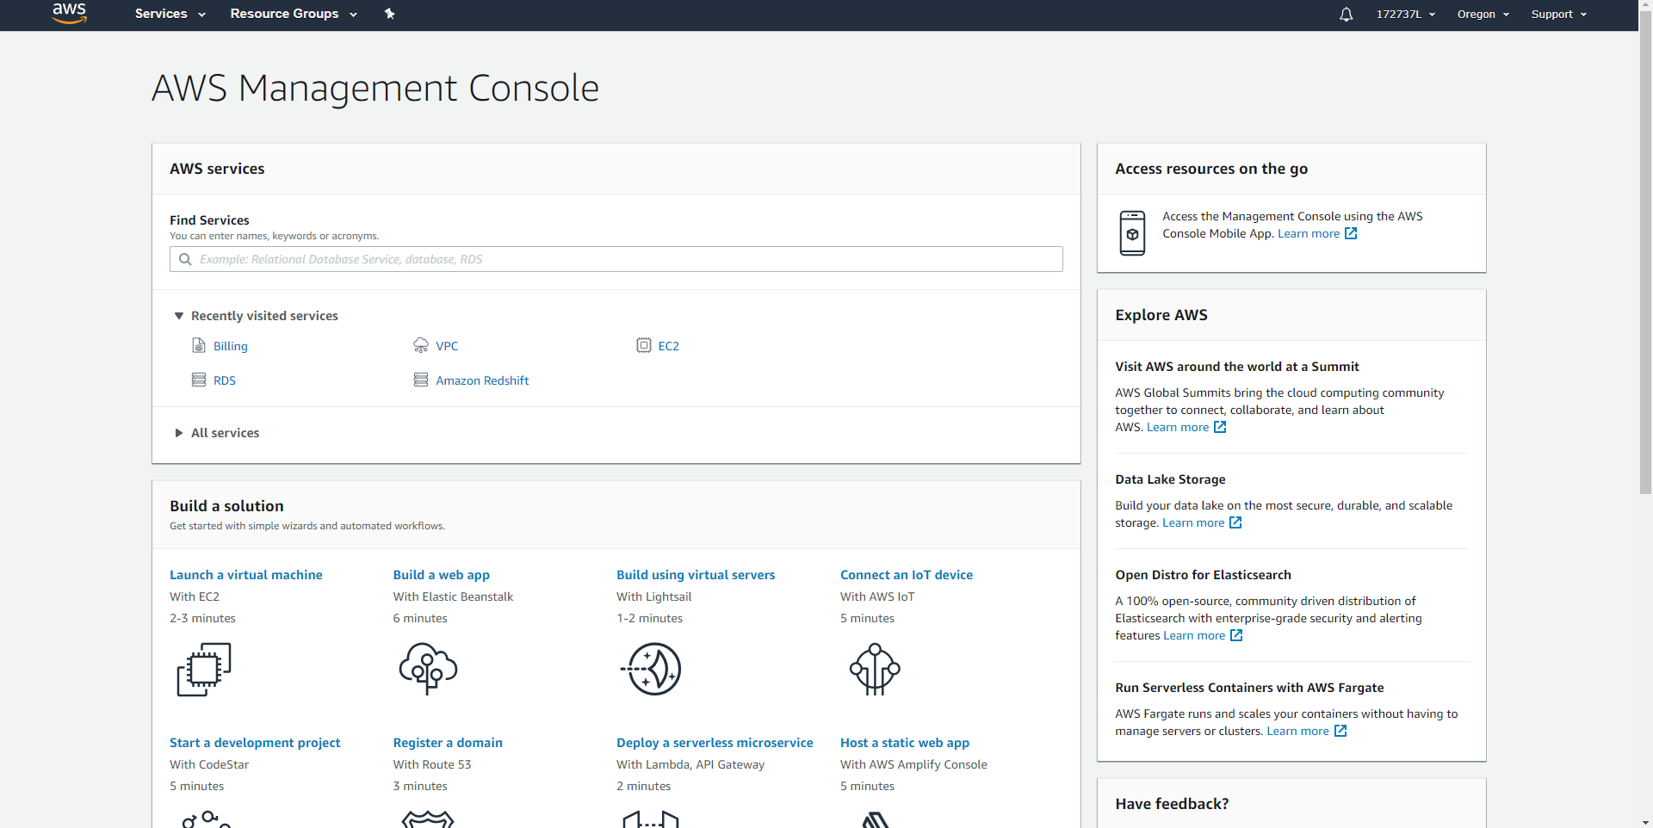

Slide 19
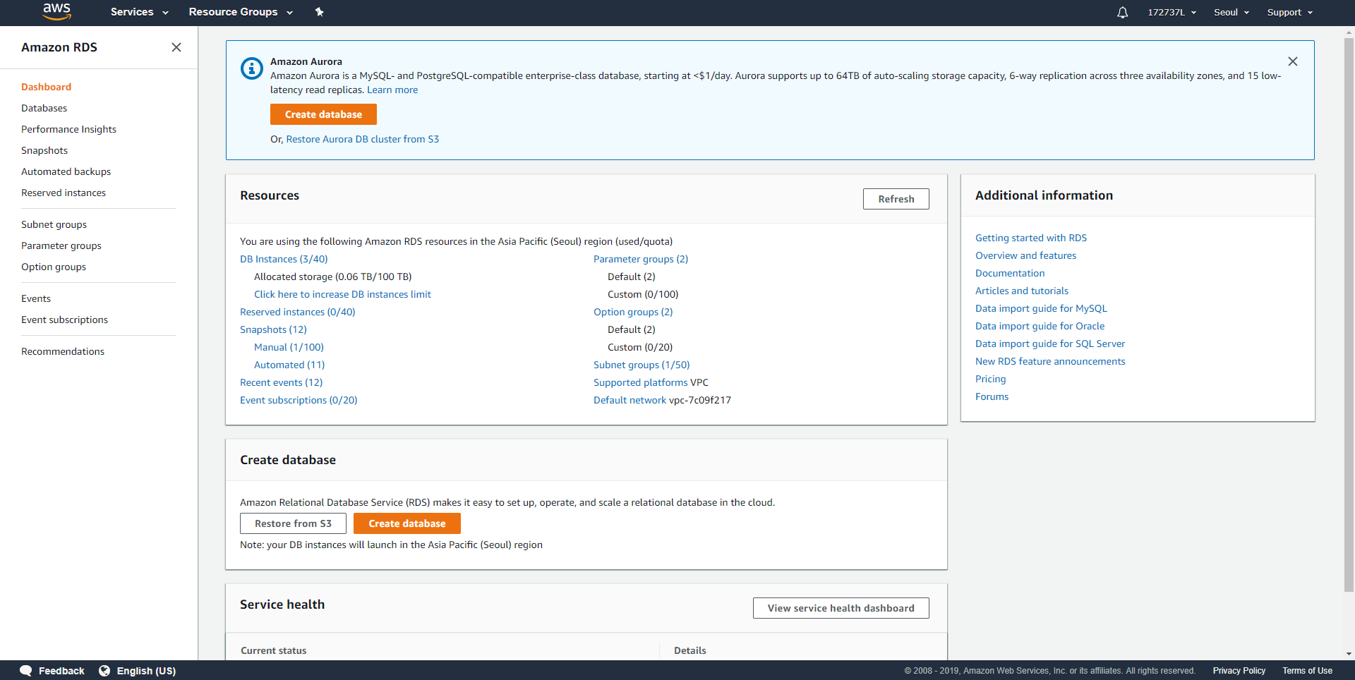
1
1
2

Slide 20
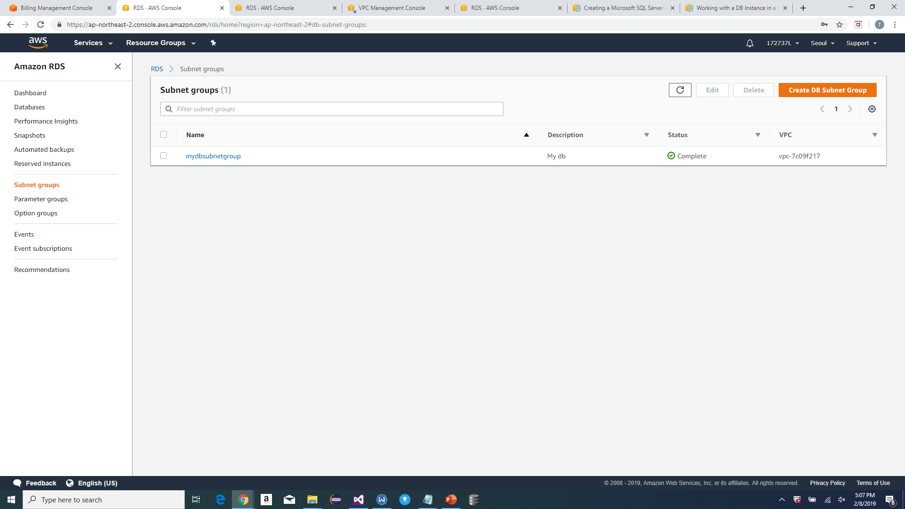
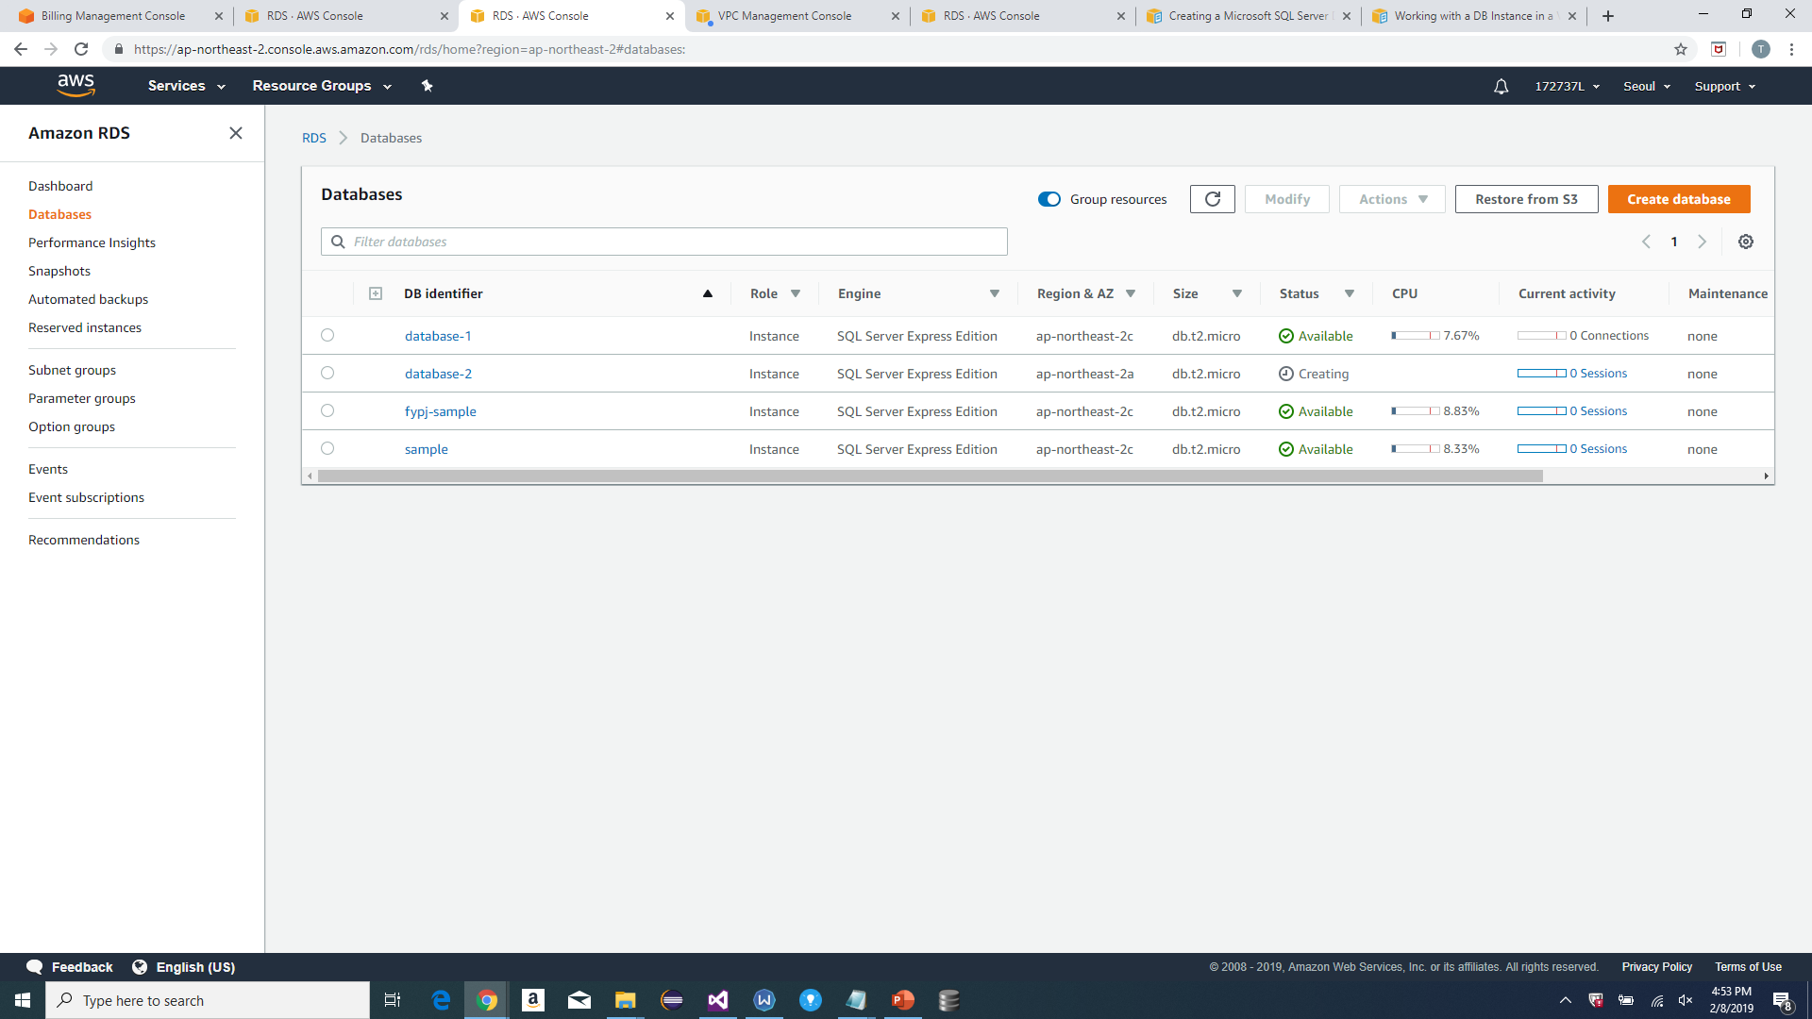

Slide 21
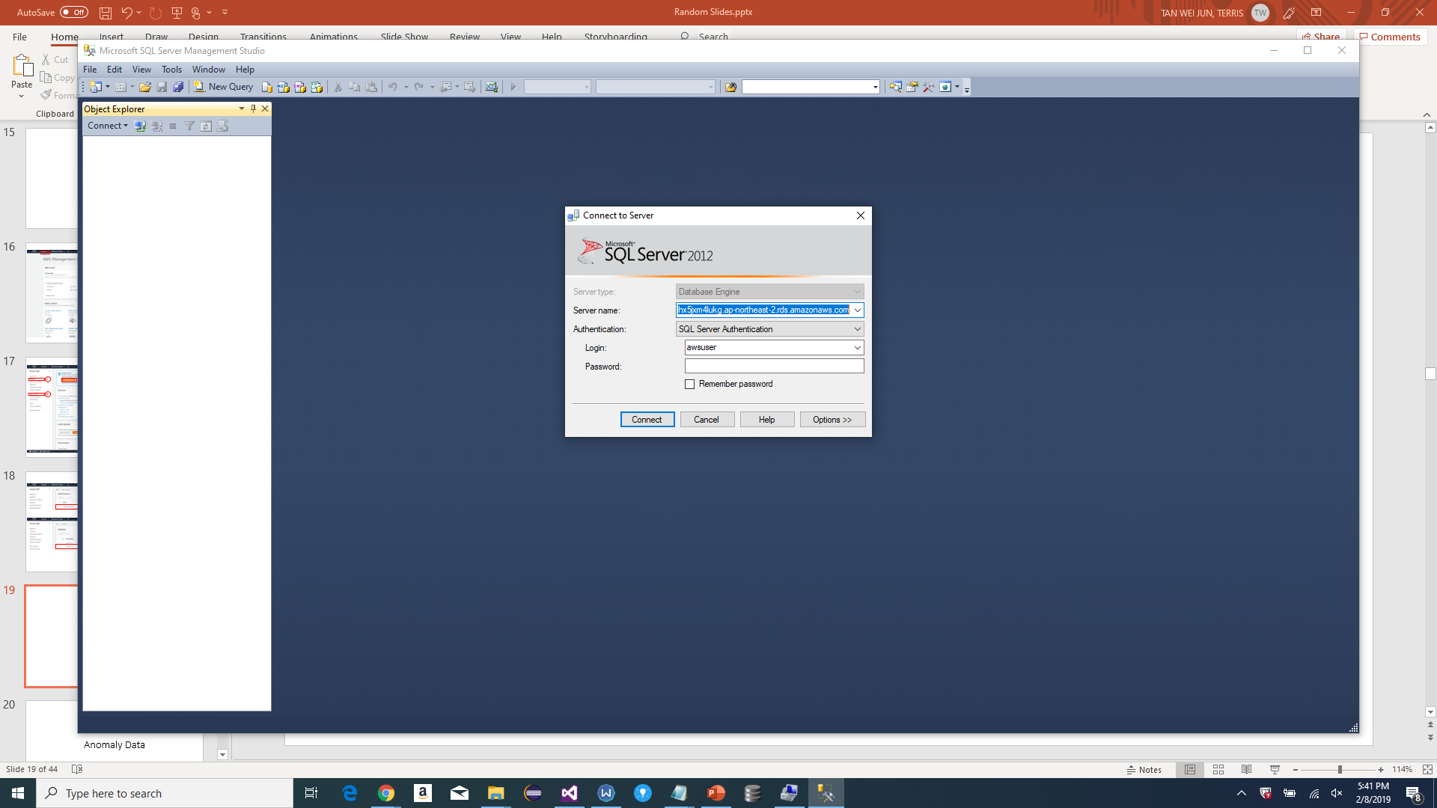
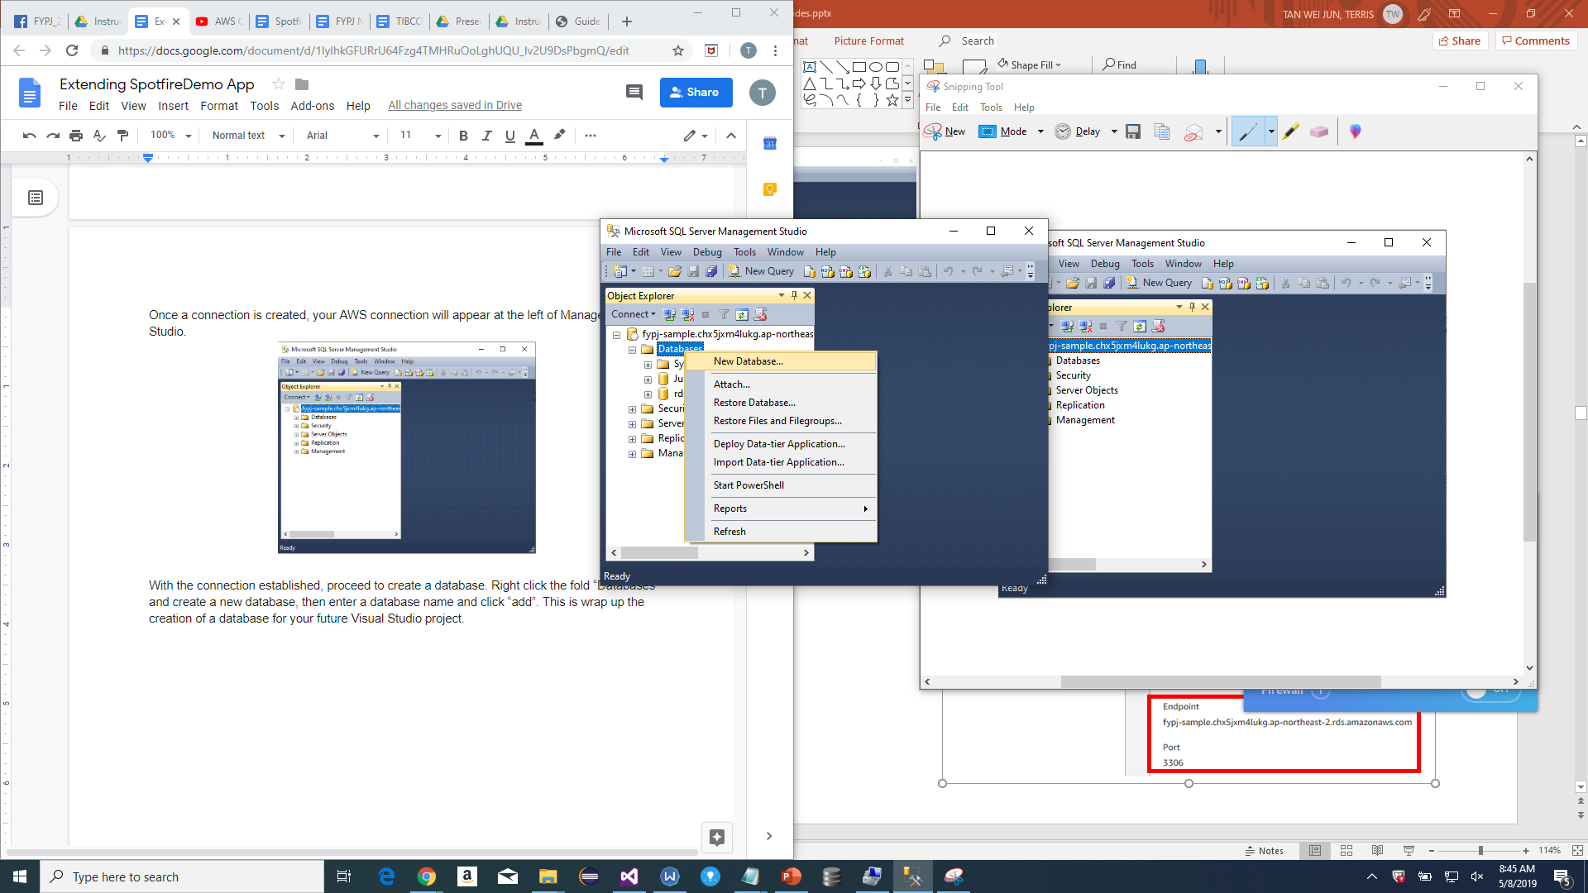
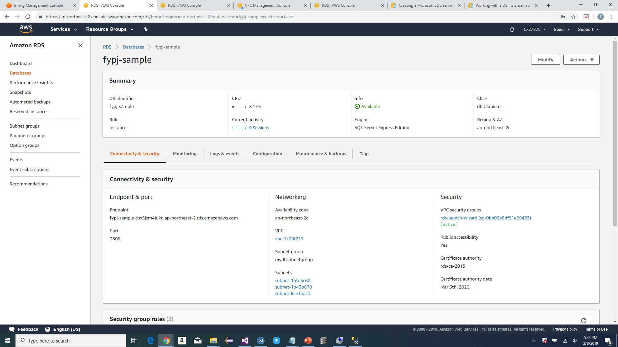
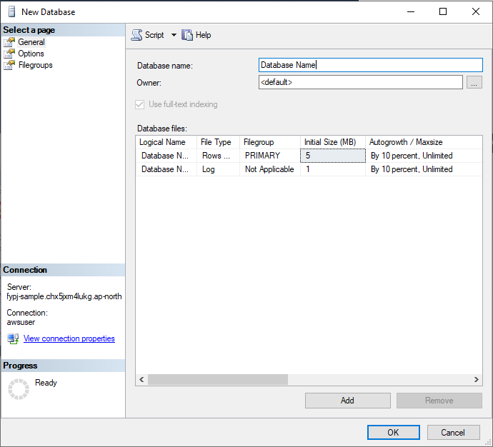

Slide 22
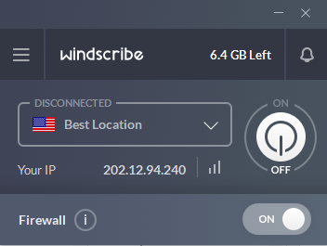
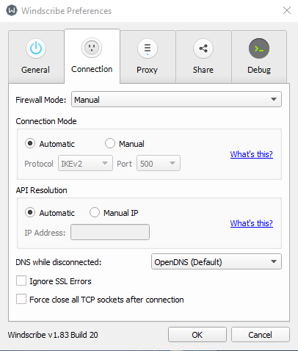
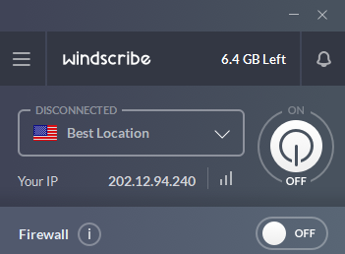

Slide 23
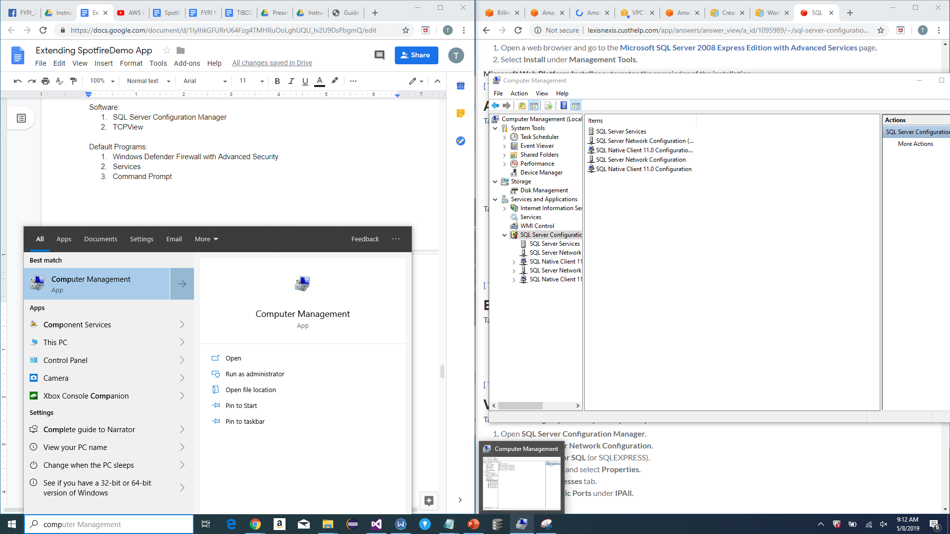
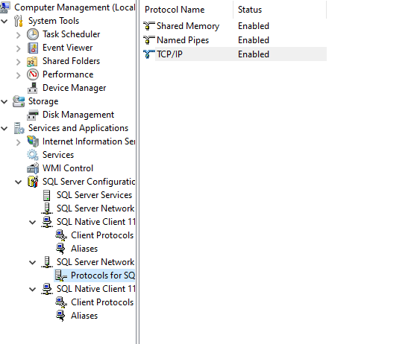
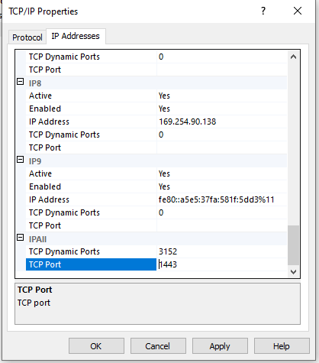
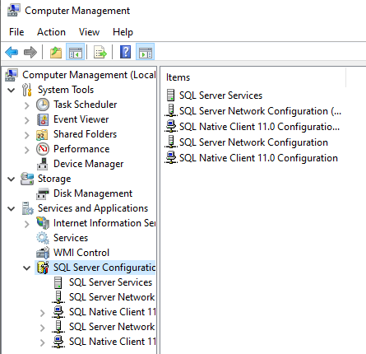
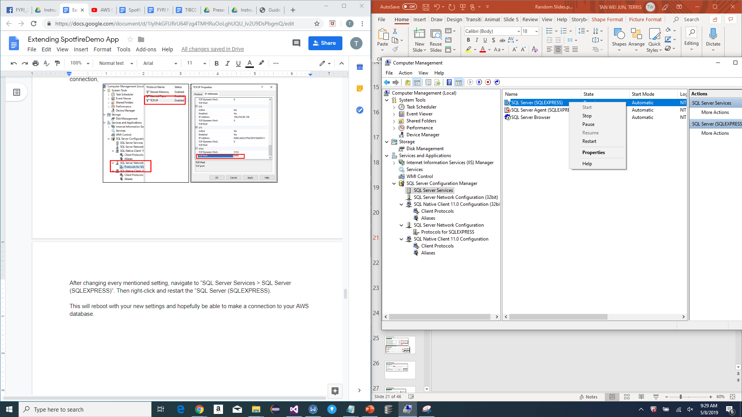

Slide 24
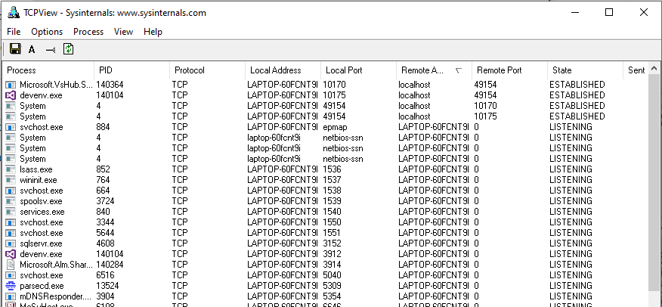
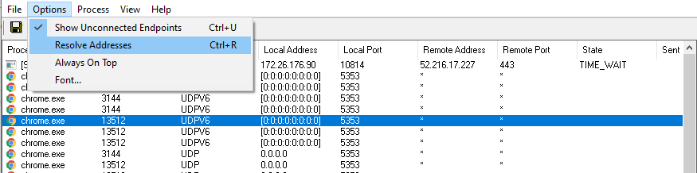

Slide 25
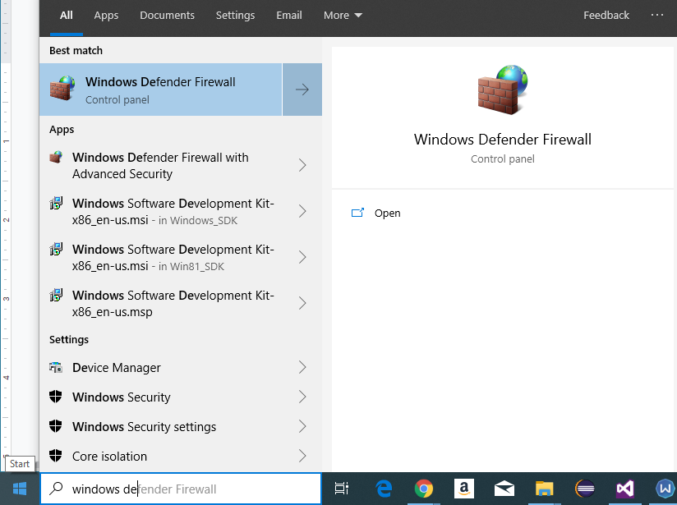
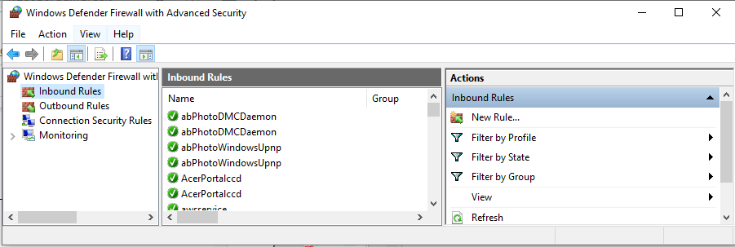
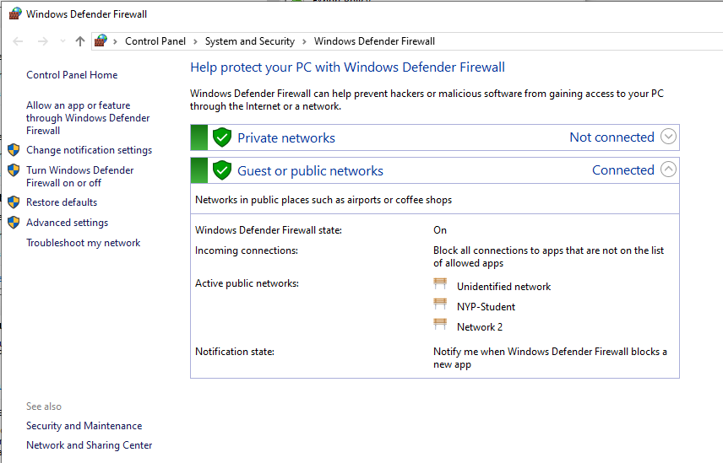

Slide 26
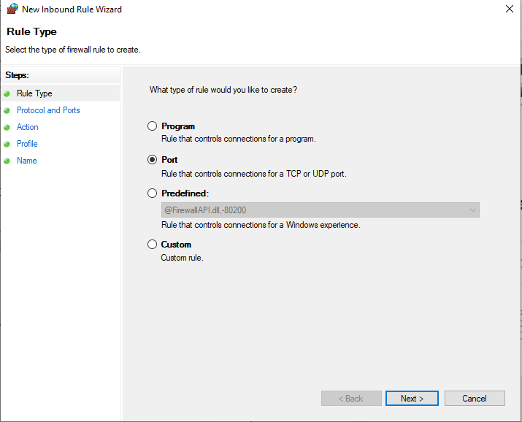
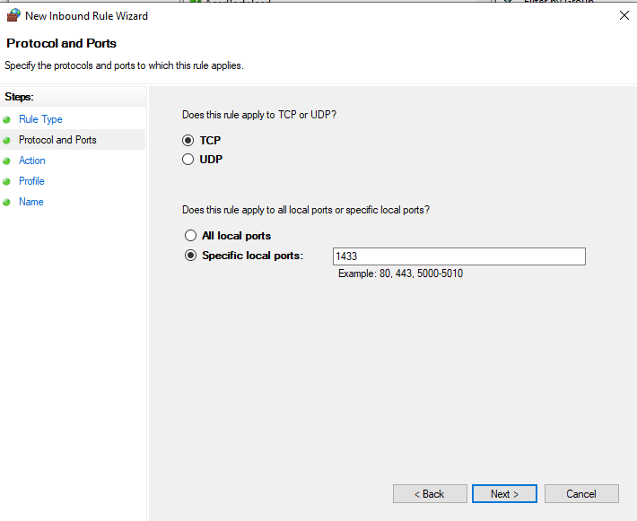
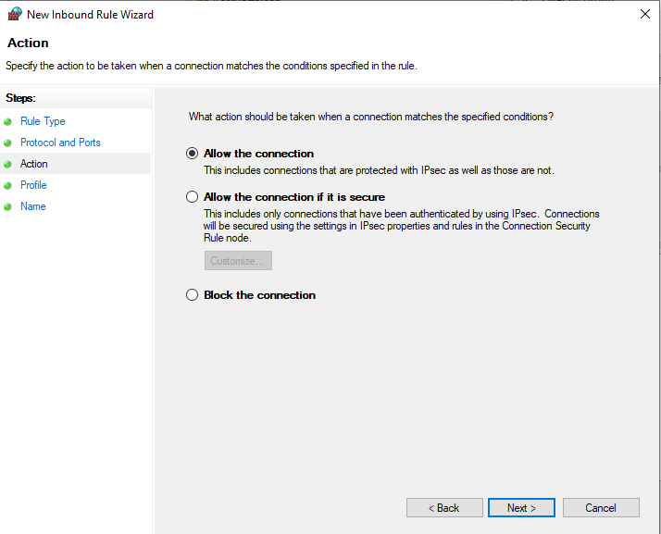
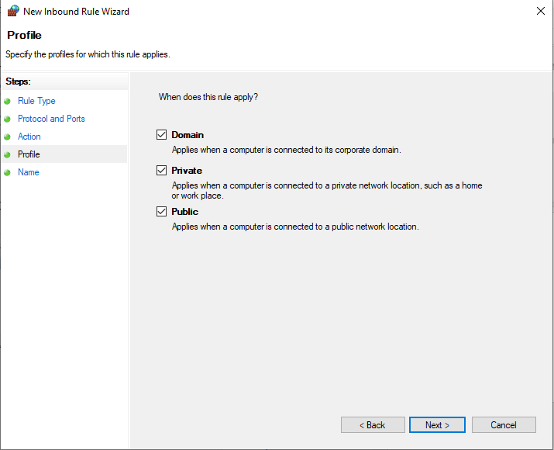
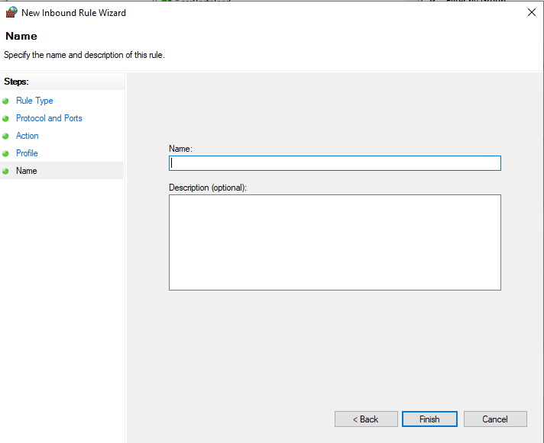

Slide 27
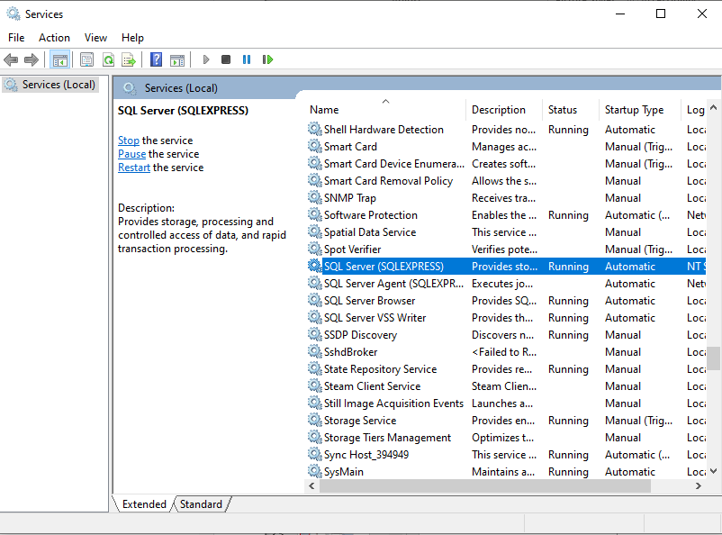

Slide 28
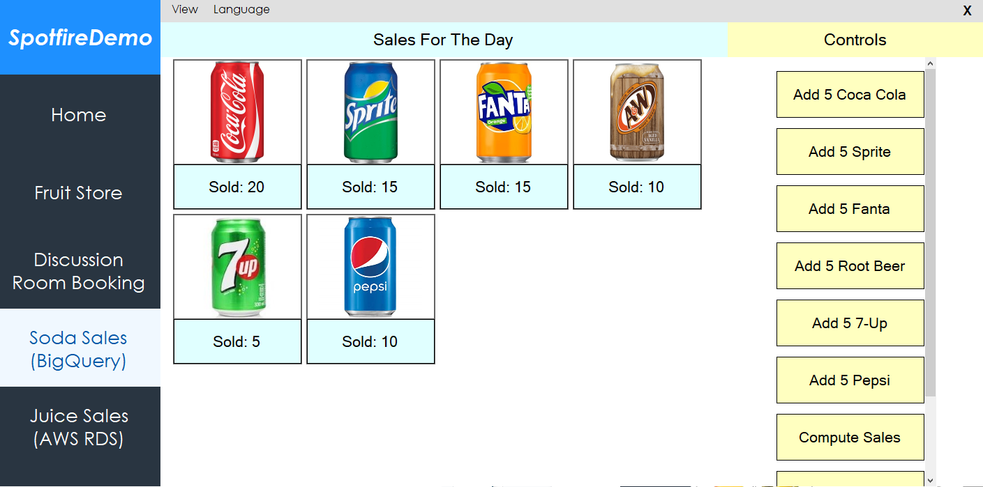
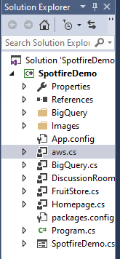
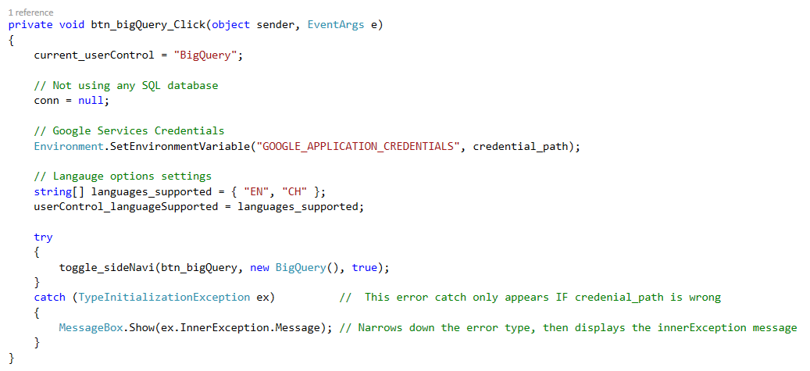

Slide 29
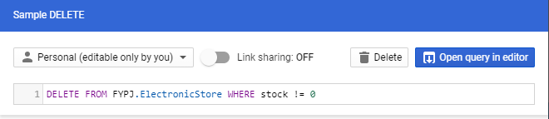
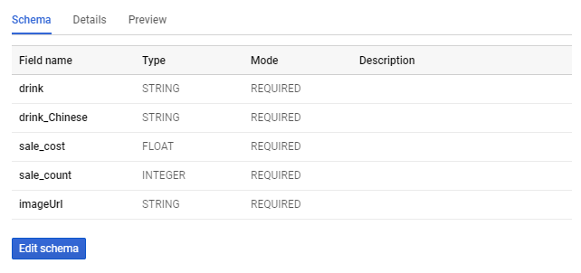
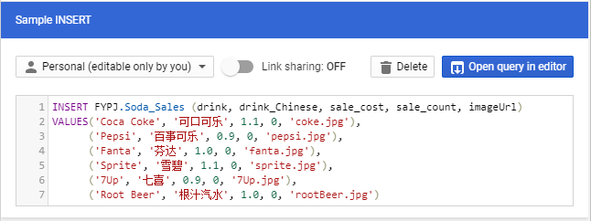
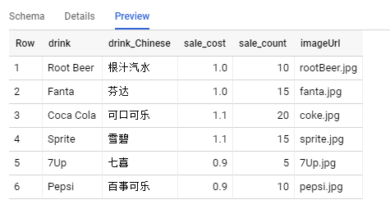



Slide 30


Slide 31




Slide 32


Slide 33




Slide 34


Slide 35
Anomaly Data

Slide 36






Data Cleaning

Slide 37
Discrepancy Data
Example Anomaly

Slide 38



Incorrect Time Stamp
Same route but time interval is obviously too close
Invalid Arrival and Departure Time
Time_Arr is larger than Time_Dep
Has Time_Arr but no Time_Dep

Slide 39


Tour Cancellation With Inputs
An input when tour cancelled

Slide 40

Extra SIT Stop Record
A route have at most 3 tour stops.
This affects the visuals in Spotfire

Slide 41
Missing End Time
Missing Time_End
Others
The SIT stop is obviously too early, and the student arrivals is zero.

Slide 42
Anomaly Data
Cancelled
List of Anomaly Data Day 1

Slide 43
Incorrect Time Stamp
Error Example
Cancelled

Slide 44
Incorrect Time Stamp (Part 1)
Before
DISCONTINUED
After

Slide 45
Incorrect Time Stamp (Part 2)
DISCONTINUED
After

Slide 46
Incorrect Time Stamp (Part 3)
Before
DISCONTINUED
After

Slide 47
Incorrect Time Stamp (Part 4)
Before
DISCONTINUED
After

Slide 48
Incorrect Time Stamp (Part 5)
Before
DISCONTINUED
After

Slide 49
Incorrect Time Stamp (Part 6)
Before
DISCONTINUED
After

Slide 50
Incorrect Time Stamp (Part 7)
Before
DISCONTINUED
After

Slide 51
Incorrect Time Stamp (Part 8)
Before
DISCONTINUED
After

Slide 52
Invalid Arrival And Departure Time
Before
Cancelled
After

Slide 53
Tour Cancellation With Inputs
Cancelled
Delete

Slide 54
Missing End Time
Before
Cancelled
After

Slide 55
Missing End Time
Cancelled
Missing Time_End

Slide 56
Anomaly Data
Cancelled
List of Anomaly Data Day 2

Slide 57
Tour Cancellation With Inputs
Before
Cancelled
After
Delete

Slide 58
Extra SIT Stop Record
Delete
Cancelled

Slide 59
Others
Before
Cancelled
After

Slide 60
AES Images

Slide 61














Research:
Capability Of
TIBCO Platform
Background
Being an educational institution, NYP formed a MOU with TIBCO to use their services. With this free access, I was given the task to research and explore the capabilities of what the TIBCO Platform could offer. During my time, I was able to fully explore the TIBCO Spotfire service
Explore Spotfire
Create Visuals
Create
C# Demos
Implement IoT Sensors
Apply
Cloud
Database

Slide 62


Slide 63


Slide 64

Discussion Room Booking
(IoT Sensor Demo)
Enter Settings
Tap Card
Add Data
View Comments
Demo Tester
IoT Sensors
(Raspberry Pi)
End Simulation

Slide 65
Database To Excel App

Slide 66

Normal Demo

Slide 67

IoT Sensor Demo

Slide 68
Cloud Database Demo

Slide 69
TIBCO Spotfire Application
Analysis
Visualization
TIBCO Spotfire
App

Slide 70
AES Usage Guide

Slide 71




Slide 72


Slide 73


Slide 74


Slide 75


Slide 76


Slide 77


Slide 78


Slide 79


Slide 80


Slide 81


Slide 82


Slide 83


